Slide 1
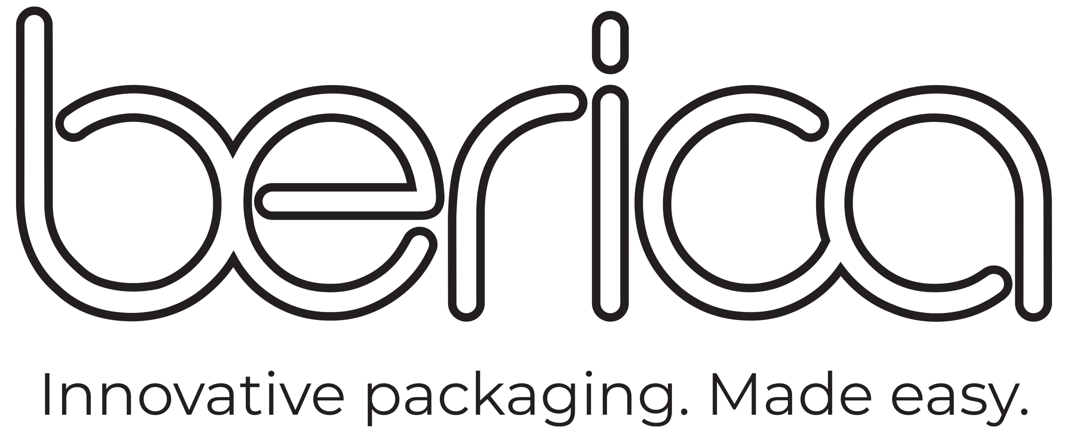
DUAL OVENABLE MEAL TRAY
BEST PRACTICE
Dual ovenable meal trays gives your customers ultimate flexibility on how they want to heat and eat their meal and they are home compostable too! Ideal for ready meals, vegetables, salads and desert applications. The trays are printed with a water-based ink which has moisture resistant properties.
Top Tips for you and your customers regarding Paperboard Meal Trays:
For best results, cook meal in another vessel and serve into trays when meal has been cooled
Meals should not be cooked in trays before sale
Meals can be frozen in these Paperboard Meal Trays but do not thaw prior to cooking
Meals should be taken directly from freezer to oven
Meals are best cooked in oven from frozen
Meals can be cooked in microwave or conventional oven
Ovenable at temperature up to 210˚C for 30 minutes
Remember to remove the rPET lid before placing in oven/microwave
Meal Trays hold a variety of food applications either hot or cold
Note these trays are all made from Paperboard with Home Compostable certification once finished eating your meal remove any excess food from tray and compost at home or local compost facility.
Click here to take you to the meal trays on our website
0800 237 422 | berica.co.nz | sales@berica.co.nz

